Slide 1

Meeting Etiquette
Please be on Mute all the time.
Turn off Video, So that we can save bandwidth.
There is separate Q&A Section in End Please use that, Add questions in Google Form.
Break at 12PM for 15 min.
Mute your microphone
To help keep background noise to a minimum, make sure you mute your microphone when you are not speaking.
Be mindful of background noise
Avoid multitasking
All links and Slides will be shared.

Slide 2

Agenda
Selenium Grid 4 (Alpha)
Locators in Selenium.
Methods in Selenium.

Slide 3
Finding Elements
Findelement
Findelements

Slide 4
Why we need to MASTER Locators ?
Probably the First question asked by Interviewer.
You should always find small and efficient Locators.
UI Automation is all about finding locators.
Tip Avoid using Tools initially.

Slide 5
Locators in Selenium.
Xpath
CSS

Slide 6
What is XPath?
XPath is a query language for selecting nodes from an XML document.
XPath was defined by the World Wide Web Consortium
Core Logic - //tagName[@attribute='value']
Relative XPath
Absolute XPath
XPath Functions

Slide 7
XPath Demo
Get the Image of VWO in app.vwo.com
URL - https://app.vwo.com/#/login
Use this Logic - //tagName[@attribute='value']
Solution - //img[@alt="Account Verification Logo"]

Slide 8
Absolute XPath
Complete path from the Root Element.
If any element is added or deleted, Xpath fails.
/html/body/div[2]/div[1]/div[2]/div/div[1]/div/div/div[3]/form[1]/ul/li[1]/div/input

Slide 9
Relative Xpath
You can simply start by referencing the element you want and go from there
Based on searching an element in DOM. //*[@id="login-username"]

Slide 10
XPath Functions
Contains()
//tag_name[contains(@attribute,'value_of_attribute')]
Starts-with()
//tag_name[starts-with(@attribute,'Part_of_Attribute_value')]
Text()
//tag_name[text()='Text of the element']

Slide 11
Operators - AND & OR
And Example
//tag_name[@name = 'Name value' and @id = ‘ID value’]
OR Example
//input[@placeholder ='Full Name' or @type = 'text']

Slide 12
XPath Axes
In the XML documents, We have relationship between various nodes to locate those nodes in the DOM structure.
Ancestor
Child, parent
Descendant
Following , following-sibling
Self.

Slide 13
XPath Axes
https://www.softwaretestinghelp.com/xpath-axes-tutorial/
//span[text()='Invalid Email']/ancestor::div
//*[@id="main-page"]/div[1]/child::div
//*[@id="js-main-container-wrap"]/child::div
//*[@id="js-main-container-wrap"]/following::div

Slide 14
XPath CheetSheet
https://devhints.io/xpath

Slide 15
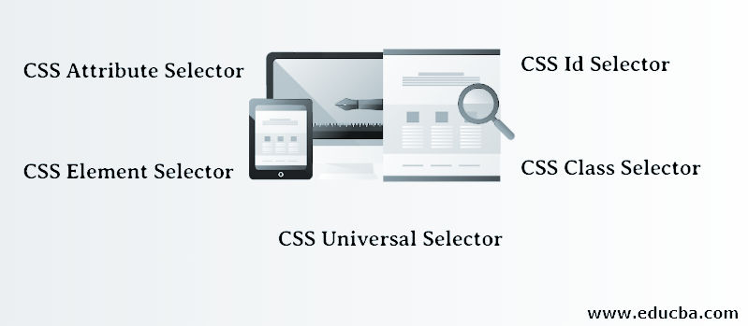
What is CSS Selectors?

Slide 16
SelectorsHub

Slide 17
QnA
Run your Selenium Grid
Try the Sign up flow of app.vwo.com
Add timeouts

Slide 18
Agenda
Difference Between findelement and findelements in Selenium
Select Demo
Alert
Waits in Selenium Mastery
Windows and iframe.
Java script executor -
Action Class

Slide 19
Assignment
Heatmap Scenario - app.vwo.com
https://katalon-demo-cura.herokuapp.com/

